Slide 1
Capstone Project Presentation
The Battle of Neighborhoods (Week2)
Sandeep Choudhary

Slide 2
A. Introduction to the business problem
B. Data used to solve problem
C. Methodology section
D. Result Section
E. Discussion Section
F. Conclusion Section

Slide 3
A. Introduction to the business problem
In this project, I chose to explore New York City and the city of Toronto and segmented and clustered their neighborhoods. Both cities are very diverse and are the financial capitals of their respective countries. One interesting idea would be to compare the neighborhoods of the two cities and determine how similar or dissimilar they are. New York City more like Toronto or Paris or some other multicultural city because The city is divided into 62 neighborhoods in total.
B. Introduction to the business problem
B.1 Analyzing Crime Data
Therefore, stakeholders require some advice on where to settle and launch their new businesses. Experience from local residents is always useful, but it is interesting to also rely on data to take a final decision.
This project will be targeted to new investors trying to find an optimal location for a new Pub

Slide 4
B.2 Identifying neighborhood
Harbourfront Queen's Park Ryerson, Garden District St. James Town The Beaches Berczy Park Central Bay Street Christie Adelaide, King, Richmond Dovercourt Village, Dufferin Harbourfront East, Toronto Islands, Union Station Little Portugal, Trinity The Danforth West, Riverdale Design Exchange, Toronto Dominion Centre Brockton, Exhibition Place, Parkdale Village The Beaches West, India Bazaar Commerce Court, Victoria Hotel Studio District Lawrence Park Roselawn Davisville North Forest Hill North, Forest Hill West High Park, The Junction South North Toronto West The Annex, North Midtown, Yorkville Parkdale, Roncesvalles Davisville Harbord, University of Toronto Runnymede, Swansea Moore Park, Summerhill East Chinatown, Grange Park, Kensington Market Deer Park, Forest Hill SE, Rathnelly, South Hill, Summerhill West CN Tower, Bathurst Quay, Island airport, Harbourfront West, King and Spadina, Railway Lands, South Niagara Rosedale Stn A PO Boxes 25 The Esplanade Cabbagetown, St. James Town First Canadian Place, Underground city Church and Wellesley Business Reply Mail Processing Centre 969 Eastern
B.3 Common Venues
For Example 1st Most Common VenueCoffee Shop Café 2nd Most Common Venue Steakhouse 3rd Most Common Venue Gastropub 4th Most Common Venue Hotel 5th Most Common Venue Restaurant and Theater , Cosmetics Shop or Gym

Slide 5
C. Methodology section
Website scraping with BeautifulSoup
Create the DataFrame
The dataframe will consist of three columns: PostalCode, Borough, and Neighborhood Only process the cells that have an assigned borough. Ignore cells with a borough that is Not assigned. More than one neighborhood can exist in one postal code area. For example, in the table on the Wikipedia page, you will notice that M5A is listed twice and has two neighborhoods: Harbourfront and Regent Park. These two rows will be combined into one row with the neighborhoods separated with a comma as shown in row 11 in the above table.
Clean the DataFrame and show the first 5 rows of the resulting DataFrame
If a cell has a borough but a Not assigned neighborhood, then the neighborhood will be the same as the borough. So for the 9th cell in the table on the Wikipedia page, the value of the Borough and the Neighborhood columns will be Queen's Park. Clean your Notebook and add Markdown cells to explain your work and any assumptions you are making. In the last cell of your notebook, use the .shape method to print the number of rows of your dataframe.

Slide 6
Use the Geocoder package or the csv file to create the following dataframe:
 | PostalCode | Borough | Neighborhood | Latitude | Longitude
0 | M5A | Downtown Toronto | Harbourfront | 43.654260 | -79.360636
1 | M7A | Downtown Toronto | Queen's Park | 43.662301 | -79.389494
2 | M5B | Downtown Toronto | Ryerson, Garden District | 43.657162 | -79.378937
3 | M5C | Downtown Toronto | St. James Town | 43.651494 | -79.375418
4 | M4E | East Toronto | The Beaches | 43.676357 | -79.293031

Slide 7
Explore and cluster the neighborhoods in Toronto.
We can decide to work with only boroughs that contain the word Toronto and then replicate the same analysis we did to the New York City data. It is up to you.
to add enough Markdown cells to explain what you decided to do and to report any observations you make. to generate maps to visualize your neighborhoods and how they cluster together. Once you are happy with your analysis, submit a link to the new Notebook on your Github repository.

Slide 8
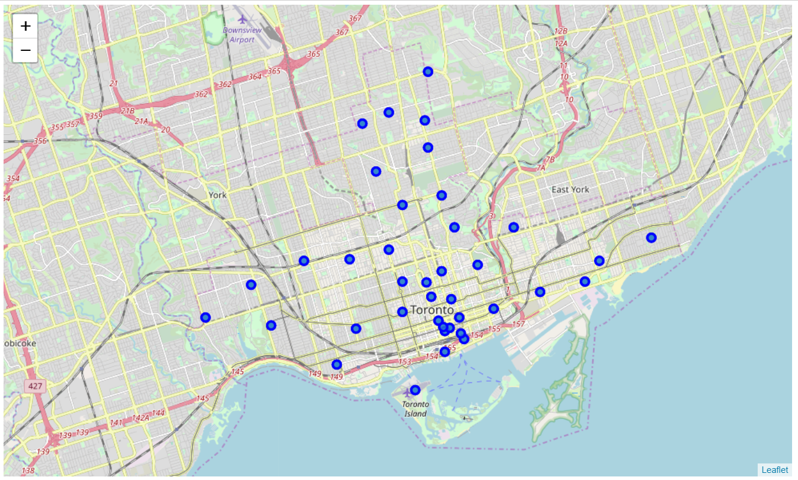
D. Results
Explore the Dataset
Replicate the same analysis we did to the New York City data
The geograpical coordinate of Toronto are 43.653963, -79.387207.
Create a map of Toronto with neighborhoods superimposed on top.

Slide 9
Define Foursquare Credentials and Version
Let's explore the first Neighborhood in our dataframe
https://api.foursquare.com/v2/venues/explore?&client_id=xxxxZ34GZ1DOLZOCN10I52Y2331VNHXLKKNCCGIQBXWYxxxx&client_secret=xxxxJEML3LVGAE1UZZSYQAZEVTEKBPBGR2YD5Q1PSTRIMPxxxx=20180605&ll=43.6542599,-79.3606359&radius=800&limit=100'
From the Foursquare lab we know that all the information is in the items key.
Before we proceed, let's borrow the get_category_type function from the Foursquare lab.
 | name | categories | lat | lng
0 | Roselle Desserts | Bakery | 43.653447 | -79.362017
1 | Tandem Coffee | Coffee Shop | 43.653559 | -79.361809
2 | Cooper Koo Family YMCA | Gym / Fitness Center | 43.653191 | -79.357947
3 | Impact Kitchen | Restaurant | 43.656369 | -79.356980
4 | Body Blitz Spa East | Spa | 43.654735 | -79.359874

Slide 10
82 venues were returned by Foursquare.
Cluster Neighbourhood and Examine Clusters
 | Neighborhood | 1st Most Common Venue | 2nd Most Common Venue | 3rd Most Common Venue | 4th Most Common Venue | 5th Most Common Venue | 6th Most Common Venue | 7th Most Common Venue | 8th Most Common Venue | 9th Most Common Venue | 10th Most Common Venue
0 | Adelaide, King, Richmond | Coffee Shop | Café | Steakhouse | Gastropub | Hotel | Restaurant | Sushi Restaurant | Theater | Cosmetics Shop | Gym
1 | Berczy Park | Coffee Shop | Café | Beer Bar | Hotel | Japanese Restaurant | Restaurant | Italian Restaurant | Cocktail Bar | Park | Cheese Shop
2 | Brockton, Exhibition Place, Parkdale Village | Coffee Shop | Café | Furniture / Home Store | Arts & Crafts Store | Bakery | Bar | Restaurant | Gift Shop | Italian Restaurant | Park
3 | Business Reply Mail Processing Centre 969 Eastern | Fast Food Restaurant | Light Rail Station | Grocery Store | Brewery | Burrito Place | Bar | Bakery | Pub | Pizza Place | Park
4 | CN Tower, Bathurst Quay, Island airport, Harbo... | Harbor / Marina | Boat or Ferry | Airport Service | Airport Terminal | Sculpture Garden | Airport Lounge | Rental Car Location | Tunnel | Coffee Shop | Bar

Slide 11
E. Discussion
The aim of this project is to help people who want to relocate to the safest borough in London, expats can chose the neighborhoods to which they want to relocate based on the most common venues in it. For example if a person is looking for a neighborhood with good connectivity and public transportation we can see that Clusters 3 and 4 have Train stations and Bus stops as the most common venues. If a person is looking for a neighborhood with stores and restaurants in a close proximity then the neighborhoods in the first cluster is suitable. For a family I feel that the neighborhoods in Cluster 4 are more suitable dues to the common venues in that cluster, these neighborhoods have common venues such as Parks, Gym/Fitness centers, Bus Stops, Restaurants, Electronics Stores and Soccer fields which is ideal for a family.
F. Conclusion
This project helps a person get a better understanding of the neighborhoods with respect to the most common venues in that neighborhood. It is always helpful to make use of technology to stay one step ahead i.e. finding out more about places before moving into a neighborhood. We have just taken safety as a primary concern to shortlist the borough of London. The future of this project includes taking other factors such as cost of living in the areas into consideration to shortlist the borough based on safety and a predefined budget.

Slide 12
Thank You

